Slide 1
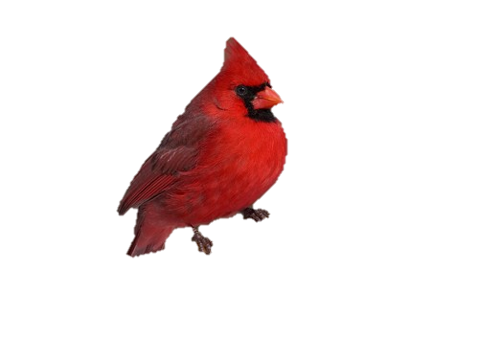
Data Visualization and Dashboards with Tableau
Dylan Fernandes
Notes:
Image1: https://theherbexchange.com/that-damn-bird/

Slide 2
Process
Connect to 2015 FAA Wildlife Strikes “cleaned” dataset
Examine different datatypes and available fields
Build visualizations to learn more about the dataset
Incorporate main categorical features
Find any patterns, trends and outliers within the data
Create a ‘story’ to annotate any findings or assumptions
Create a ‘dashboard’ to answer questions about the data
Notes:
- main categorical features: i) effect, ii) when, iii) wildlife

Slide 3

Visualizations Used
Map Chart
Forecast Line Chart
Treemap Chart
Stacked Bar Chart
Highlight Table
Horizontal Bar Chart
Notes:
Map: to see how the number of strikes vary based on the state
Forecast line: to observe the number of strikes over the years and predict current data to determine how accurate the model is
Treemap: to determine the relative sizes by number of strikes of each species within each category
Stacked bar: to show a how the number of strikes over the years changes depending on the time of day and unlike a scatterplot variation of this visualization we can see a cumulative sum depending on the selection of time of day (a scatterplot would only show individual times)
Highlight table: to depict the effect the damage has on the impact of the flight based on the number of strikes, as text and enhancing important numbers
Horizontal bar: to provide information on the number of strikes at each phase of flight with corresponding costs associated with each phase
Image2: https://boostlabs.com/10-types-of-data-visualization-tools/

Slide 4
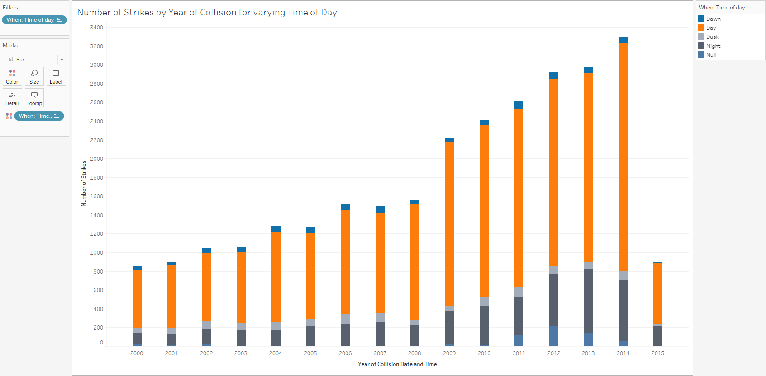
Features of the Dataset
Dataset contained incomplete data for year 2015
Dropped

Slide 5
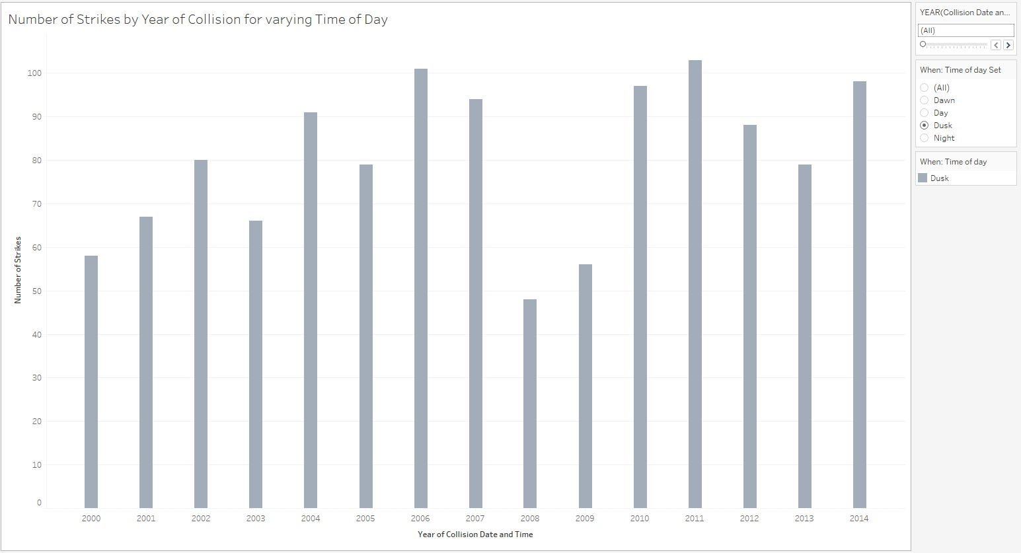
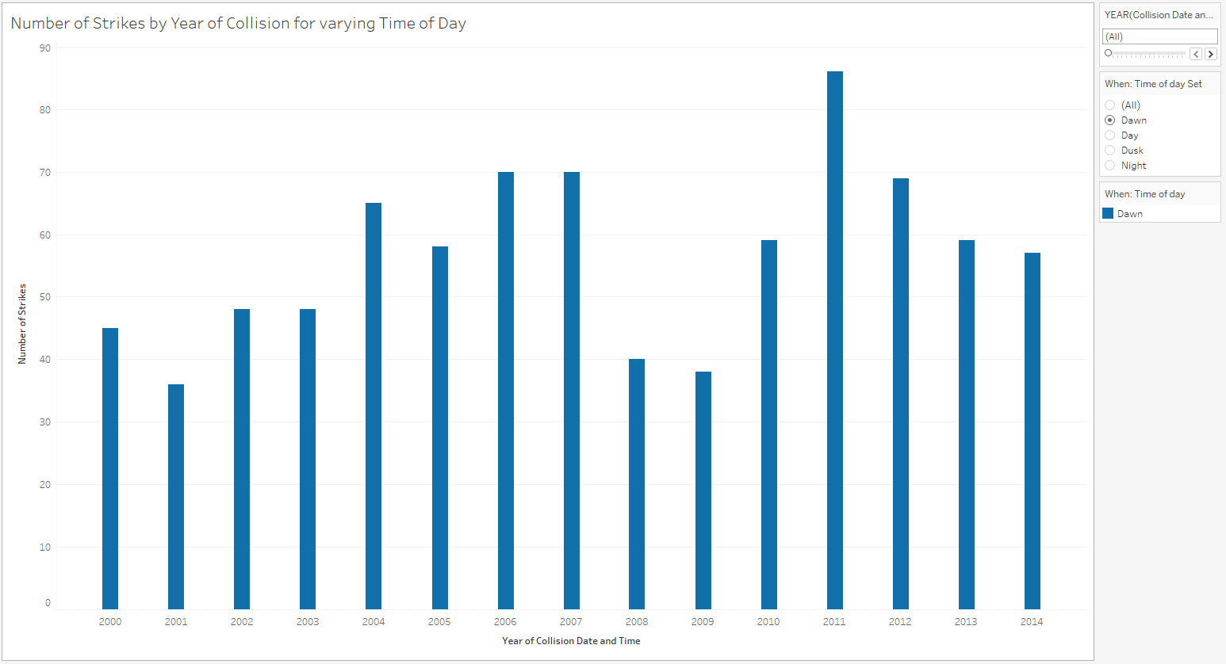
Features of the Dataset
The visualizations and dataset depict outliers
Unmodified
Notes:
- From the previous slide, we can say (for the most part) the number of strikes increases with each passing year, but for specific times of the day like “dusk” or “dawn” their could be considered outliers present for years 2008 and 2009 or year 2011, respectively

Slide 6
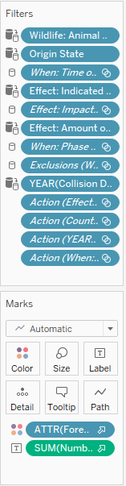
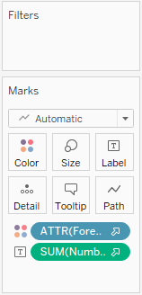
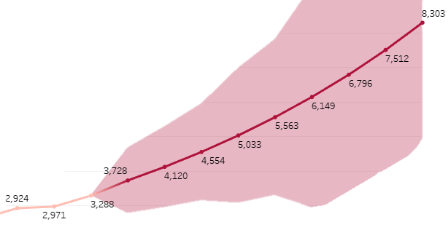
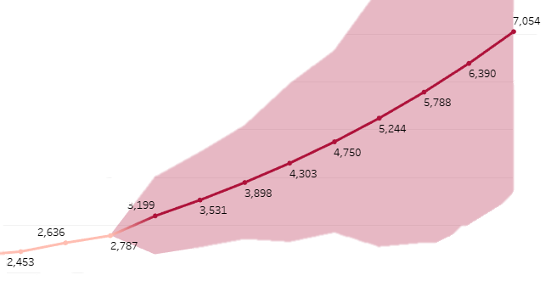
Features of the Dataset
The visualizations would contain null data
Excluded from view
Filtered by other sheets

Slide 7
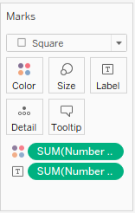

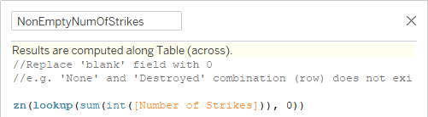
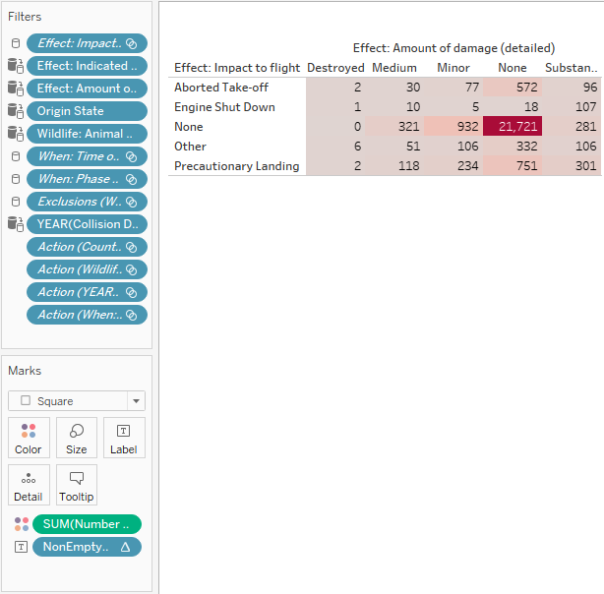
Features of the Dataset
The visualizations would contain blank field(s)
Adjusted using calculated field
Notes:
‘int’ is used as a conversion and ‘sum’ is used to perform aggregation to apply ‘lookup’
The equation lookup(sum(int([Number of Strikes])), 0) looks at the current row and column combination it is at (based on 0 offset) and returns the (same) result, otherwise (if a result does not exist) it will return NULL (to the blank or empty field) and in doing so a colour is assigned
‘zn’ returns an expression if it is not null, otherwise it returns 0

Slide 8
What Questions can be Answered?
To name a few, we can answer questions related to
Spatial analysis
Temporal analysis
Wildlife species
Effect of strikes
Aircraft and flight phase analysis

Slide 9
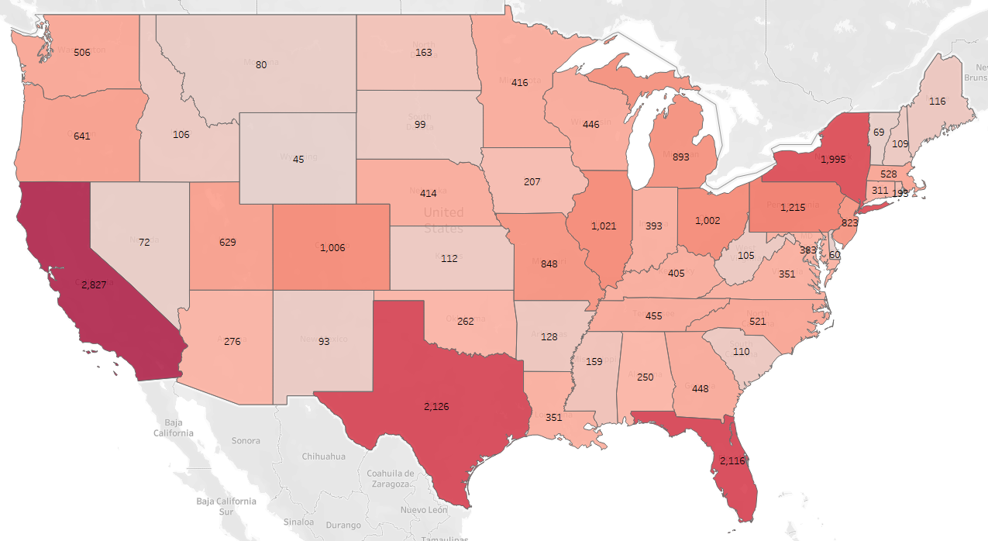
Where do wildlife strikes most frequently occur?
The highest number strikes are 2,827, 2,126 and 2,116 which occur in California, Texas and Florida, respectively.

Slide 10
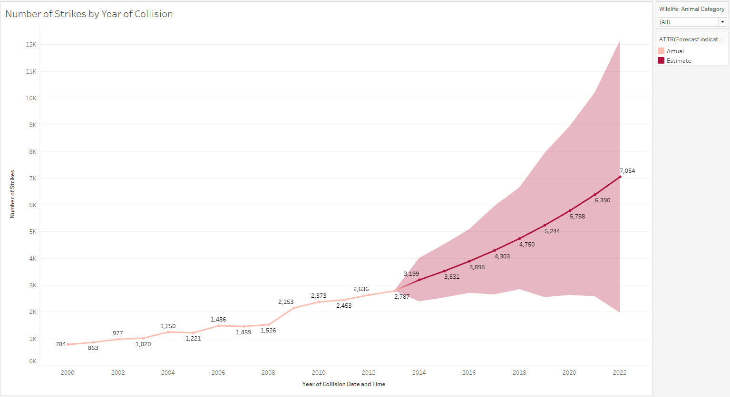
What is the trend of wildlife strikes over the years?
How accurate is the model at predicting future results?
There appears to be exponential growth in the number of strikes with each year. The model predicts approximately 12,000 wildlife strikes in the year 2022, but according to a 1990-2022 FAA Wildlife Strike Report 17,190 strikes were reported.

Slide 11
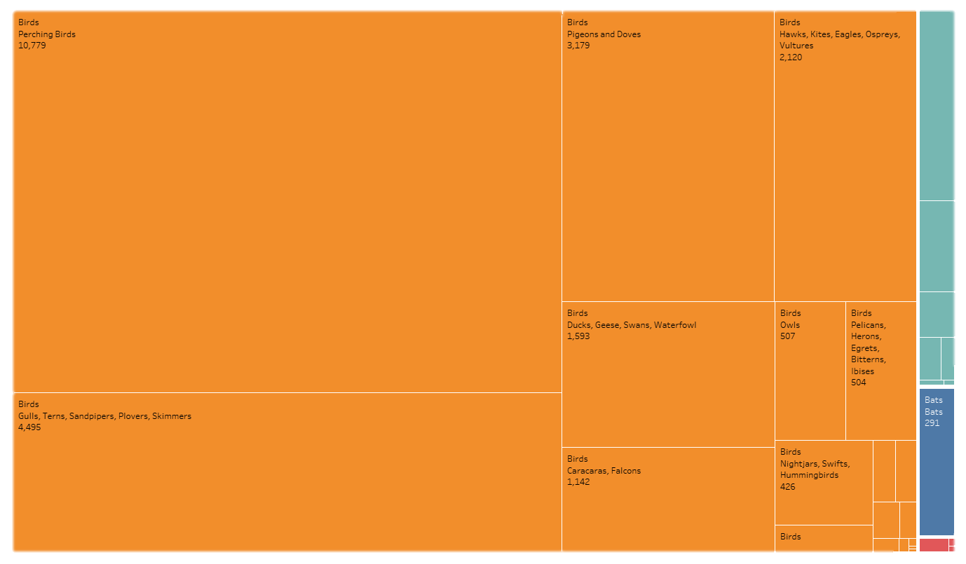
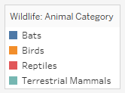
Are there particular wildlife categories more commonly involved?
Of the categories, which wildlife species are most frequently involved?
Birds account for majority of the wildlife strikes. More specifically, perching birds (e.g. crows, mockingbirds and sparrows) are the most prone to incidents.

Slide 12
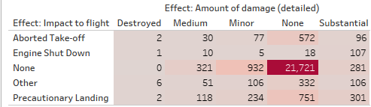
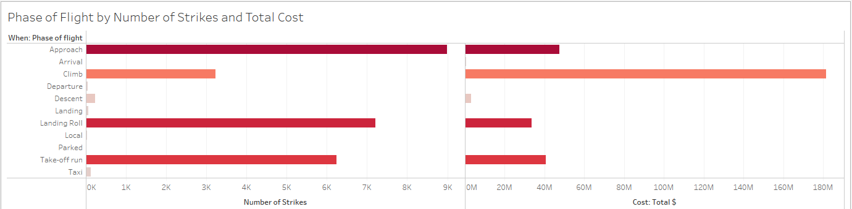
What is the impact of strikes on flight operations?
How does the effect of strikes vary with the phase of flight?
Overall, there is little to no impact of strikes on flight operations. Most of the strikes occur at low altitude and speed where the severity of damage is low.
Notes:
Less kinetic energy
Lower impact force
Less momentum
Bird size and mass; smaller birds more common at lower altitudes

Slide 13
How does the cost associated with the different phases of flight vary?
What are possible causes?
The total cost is higher for the climbing phase than it is for approach, landing roll and take-off run. The latter three phases involve lower altitude and speed where the force of impact would be lesser and smaller birds (and other categories of animals) more common.
Notes:
Less kinetic energy
Lower impact force
Less momentum
Bird size and mass; smaller birds more common at lower altitudes

Slide 14
Challenges
The dataset did not include other useful data
Developing a user-friendly dashboard (balance analysis with clear flow of information)
Ensuring data quality (deal with null, outliers and inconsistencies)
Notes:
For example, the dataset did not include the number of flights to check any correlations with the number of strikes and the number of flights or the types of aircraft
In the dashboard considerations needed to be made for varying desktop sizes, whether or not the user is colourblind, etc.

